Slide 1

Data-Driven Insights into Bike Sharing Demand Behavior
Analysis of Bike Rental Patterns Using Various Different Conditions
Submitted By :- Yug Rathi

Slide 2
Problem Statement
Bike-sharing systems generate large amounts of data related to time, weather, and user behavior.
This data is often not effectively analyzed to understand demand patterns.
Lack of clear insights makes it difficult to identify peak usage and demand drivers.
Inefficient analysis can lead to poor resource planning and operational decisions.

Slide 3
Datasets & Scope of Analysis
•Dataset 1 :- Time, date, season, weather, temperature
•Dataset 2 :- User type and rental count data
•Dataset 3 :- Additional contextual variables
•Combined_Data_1&2 :- Dataset 1 + Dataset 2 combined
•Final_Combined_Dataset :- Dataset 1 + Dataset 2 + Dataset 3 combined

Slide 4
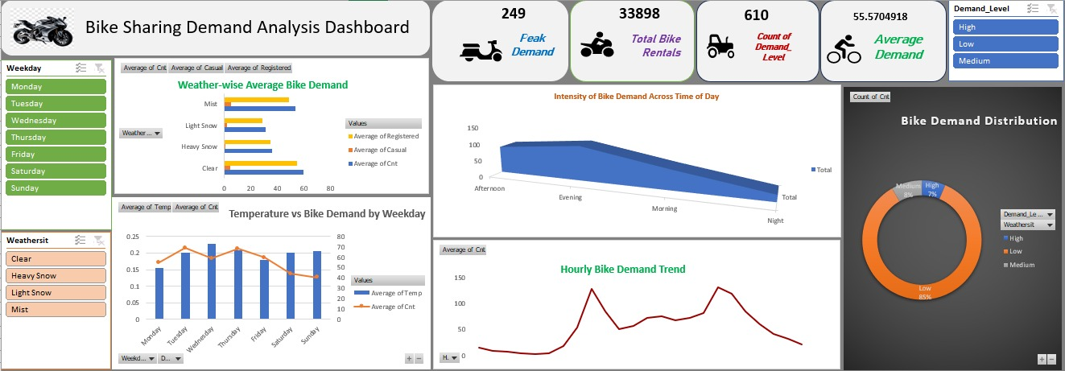
Smart Insights into Bike-Sharing Demand Patterns
Demand peaks during daytime hours.
Clear/mild weather drives higher usage.
Weekdays lead demand, showing commute dependence.
Registered users dominate rentals.
Bike-sharing demand is predictable, commuter-focused, and shaped by time and weather conditions.

Slide 5
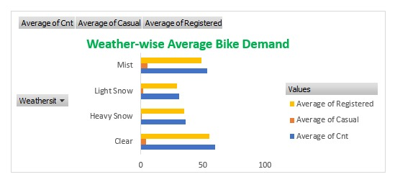
Impact of Weather on Rider Demand Patterns
Clear weather drives the highest and most balanced demand, indicating stable usage from both casual and registered riders.
Registered riders remain active even in misty conditions, showing weather-resilient commuter behavior.
As weather worsens, casual demand drops faster than registered demand, shifting usage toward essential travel only.

Slide 6
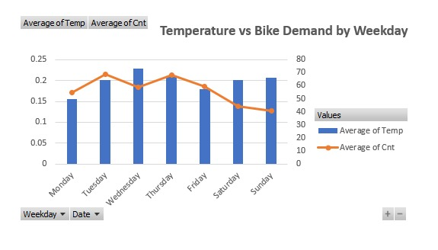
Weekday Temperature Influence on Bike Demand
Bike demand peaks on mid-week days (Tue–Thu) even when temperature changes are moderate, indicating routine-driven commuting behavior.
Higher temperatures on weekends do not translate into higher demand, suggesting leisure rides are influenced by factors beyond temperature alone.
Demand drops on Saturday and Sunday despite favorable temperatures, highlighting that weekday demand is necessity-based rather than weather-dependent.

Slide 7
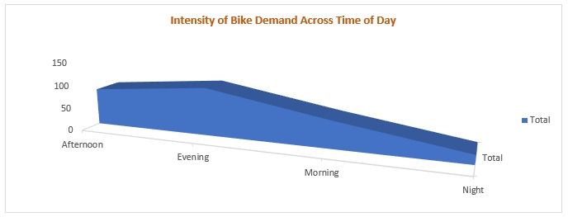
Daily Demand Rhythm: How Bike Usage Shifts by Time of Day
Evening hours show the highest demand intensity, reflecting post-work and return-trip clustering rather than spread-out usage.
Morning demand is lower but more consistent, indicating structured, time-bound travel compared to flexible evening rides.
Night usage drops sharply, highlighting a clear operational low-activity window for maintenance and resource optimization.

Slide 8
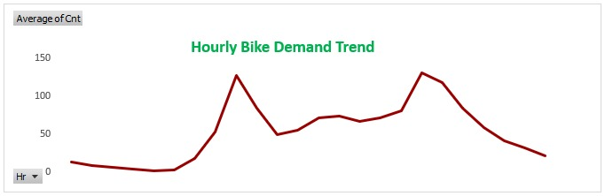
Hourly Demand Curve Reveals Peak Usage Windows
Two sharp demand spikes indicate synchronized user behavior, pointing to fixed daily travel windows rather than random ride distribution.
Midday demand remains moderate instead of collapsing, suggesting secondary usage such as short errands or flexible schedules.
Demand tapers gradually after the evening peak, showing ride completion patterns rather than abrupt service drop-off.

Slide 9
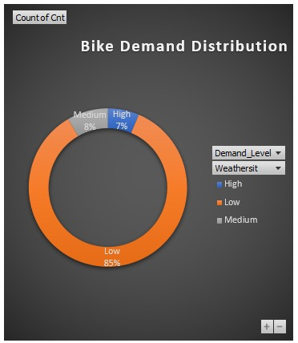
Demand Concentration Across Usage Levels
Bike usage is dominated by low-demand periods, indicating that high-volume usage is occasional rather than the system norm.
High-demand instances form a small but critical share, suggesting short-duration stress points rather than sustained overload.
Medium demand acts as a transition zone, reflecting fluctuating usage rather than stable mid-level performance.

Slide 10
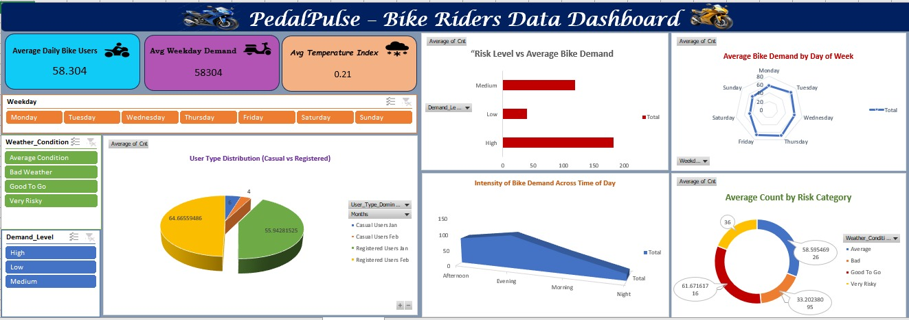
Pedal Pulse: Data-Driven Insights into Bike Demand Behavior
Bike demand is consistently strong and commuter-driven, with higher usage on weekdays than weekends.
Daytime hours record peak demand, aligning with daily work and travel routines.
Registered users dominate total demand, ensuring stable and recurring usage.
Weather and risk conditions influence demand intensity but do not stop usage, indicating rider resilience.
Overall patterns show reliable, time-based, and necessity-focused bike usage.

Slide 11
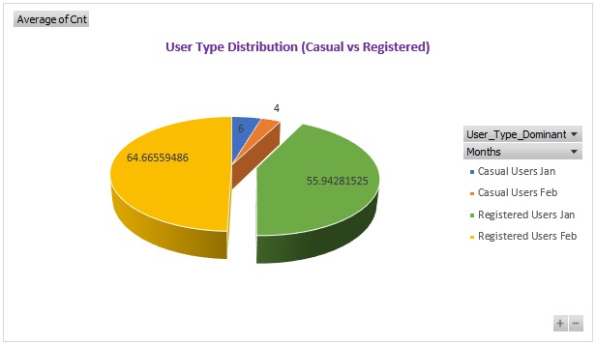
Seasonal Shift in User Composition: Casual vs Registered Riders
Registered users consistently form the majority share, indicating that platform usage is anchored by long-term subscribers rather than occasional riders.
Casual user contribution remains limited even across months, showing that short-term adoption does not scale proportionally with overall demand.
Month-wise variation affects volume more than user mix, meaning growth or decline happens within the same dominant user segment.

Slide 12
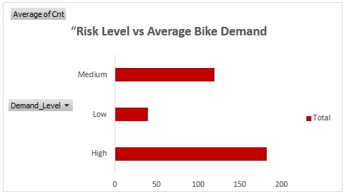
Bike Demand Peaks Under High-Risk Conditions
Highest average bike demand occurs during High-Risk conditions, indicating that users continue to rely on bikes even when conditions are unfavorable.
Medium-Risk conditions show moderate demand, suggesting partial hesitation but continued usage.
Low-Risk conditions have the lowest average demand, implying that demand is not solely driven by favorable conditions but by necessity and usage patterns.

Slide 13
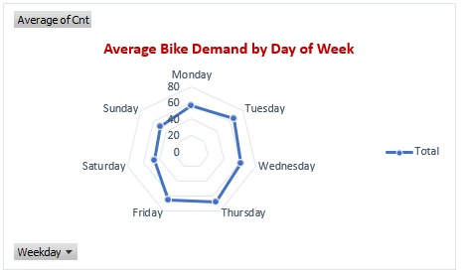
Midweek Dominates Bike Usage Patterns
Bike demand is strongest on working days, highlighting a clear link with daily commuting behavior.
Midweek days outperform weekends, showing consistent usage rather than leisure-driven demand.
Weekend demand drops noticeably, indicating reduced dependency on bikes for routine travel.

Slide 14
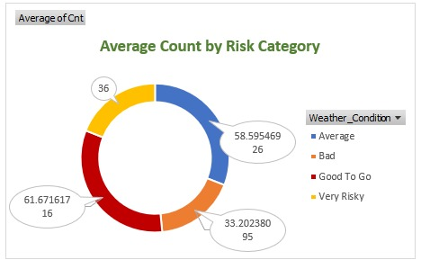
Demand Concentration Shifts with Risk Severity
‘Good To Go’ conditions contribute the largest share of average demand, making them the most reliable operating scenario.
Even under ‘Bad’ and ‘Very Risky’ conditions, demand remains significant, showing strong user dependency on bike services.
Demand is distributed across all risk categories, indicating resilience rather than sensitivity to a single condition type.

Slide 15
Final Conclusion
Bike-sharing demand is predictable and commuter-driven, with higher usage on weekdays.
Daytime hours show peak demand, aligning with work and travel routines.
Registered users dominate total rentals, ensuring consistent usage.
Weather and risk conditions affect demand levels but do not stop usage, indicating system resilience.
Overall trends support efficient planning and data-driven decision-making.

Slide 16
Thank You
This analysis demonstrates how data-driven insights can be used to understand bike-sharing demand patterns, improve operational planning, and support informed decision-making.

